Slide 1
Year 10 Electronics
The Design & Make Task
This project is made up of two parts:-
The Design Folder & The Artefact
The Artefact must be a fully functional electronic circuit enclosed in a protective case produced using CAD & CAM
The Design Folder has six chapters
Chapter One – The Introduction
Chapter Two – The Research
Chapter Three – The Specification List
Chapter Four – Designs
Chapter Five – How to Make It
Chapter Six – The Evaluation

Slide 2
Year 10 Electronics
Evaluation
How to Make
The Design Folder
Designs
Specification
Research
Introduction

Slide 3
Year 10 Electronics
Project Two -
Personal Security Light
Chapter One – The Introduction
Learning about more electronics theory and Integrated Circuits.
Learning about the use of the 555 Timer Chip.
Learning about Astable & Monostable circuits.
How electronic components can be combined together to produce predetermined outcomes.

Slide 4
Year 10 Electronics
Chapter One – The Task Analysis
Fixed & Variable
Resistors
PCB’s
Printed Circuit
Boards
LED’s
Security
Light
Integrated
Circuits
Analogue/Digital
Converters
Sensors
Transistors
Potential Dividers

Slide 5
Year 10 Electronics
Chapter One – The Plan of Action
Analyse the Task – Identify what you need to find out about.
Research the things you need to know more about.
Draw up a product specification list.
Produce the design details for your product.
Build it.
Test it and evaluate it.

Slide 6
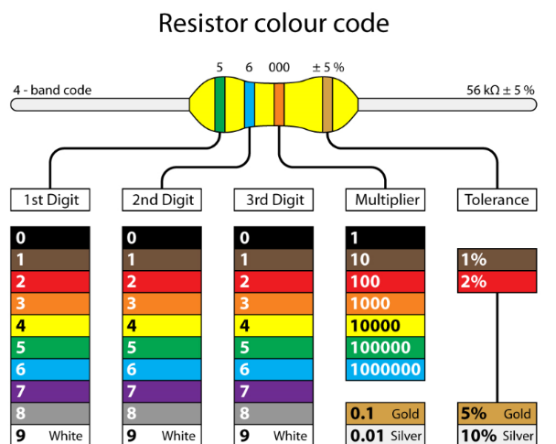




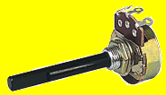
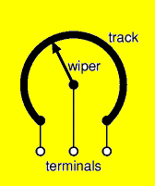
Year 10 Electronics
Chapter Two – The Research
Fixed Resistors
Picture
Symbol
Variable Resistors
Symbol
How it
Works
Picture

Slide 7

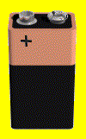
Year 10 Electronics
Chapter Two – The Research
Potential Difference & Potential Dividers
Potential Difference is measured in Volts.
A single Cell produces 1.5 Volts
Cell
Symbol
Picture
Battery
A Battery is made up from a group of cells.
A Battery will produce
1.5 Volts x the number of cells in it.
Picture
Symbol

Slide 8
Year 10 Electronics
Chapter Two – The Research
Electrical Polarity
In electronics polarity refers to the direction that the electricity flows through the circuit.
Through the
Circuit.
The electricity flows out
from the positive terminal
Then back into the
neutral terminal
The positive
terminal
+V
The neutral
terminal
0V
Polarity is important
because most electronic
components will only work
when the electricity flows
through them in the right
direction.
A battery has two terminals

Slide 9
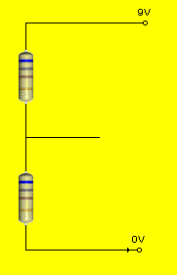


Year 10 Electronics
Chapter Two – The Research
Potential Divider
Live Rail
R1
R1
Variable Output
R2
R2
Ground Rail

Slide 10
Year 10 Electronics
Chapter Two – The Research
Potential Dividers - The Rules
If R1 & R2 are of equal value the voltage at the variable output will be half of the supply voltage (Potential Difference).
R1
If R1 is stronger than R2 the voltage at the variable output will be less than half of the supply voltage (Potential Difference).
Variable
Output
R2
If R2 is stronger than R1 the voltage at the variable output will be greater than half of the supply voltage (Potential Difference).

Slide 11
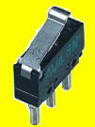




Year 10 Electronics
Chapter Two – The Research
Sensors
Are special components that react to something happening.
Micro-Switch
Reacts to pressure
Symbol
Reacts to temperature changes
When the temp goes up - its resistance goes down
Thermistor
Symbol
LDR
Reacts to changes in light levels
When the light level drops - its resistance goes up.
Light
Dependant
Resistor
Symbol

Slide 12
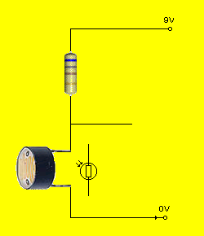
Year 10 Electronics
Chapter Two – The Research
How the sensor for this circuit works
As the light level drops the resistance of the LDR increases.
R1
As R2 gets stronger than R1 the voltage at the variable output will gradually rise.
R2
When the voltage at the variable output rises it will trigger the circuit to switch on a light.

Slide 13
Year 10 Electronics
Chapter Two – The Research
Digital Sensors
A digital sensor is usually a component that acts like an on/off switch.
Micro-Switch
Reacts to pressure
Analogue Sensors
An analogue sensor is usually a specialised resistor. Its resistance will change in response to a change in the environment.
LDR
Reacts to changes in light levels
When the light level drops - its resistance goes up.
Light
Dependant
Resistor

Slide 14


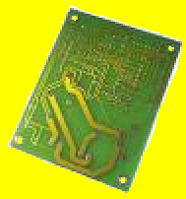
Year 10 Electronics
Chapter Two – The Research
Light Emitting Diodes
Ultra Bright LED’s are now replacing conventional light bulbs.
Printed Circuit Board - PCB
PCB’s are made using several techniques. Originally, circuits were prototyped on connector boards known as Breadboards. Breadboards allow the designer to interchange components quickly in order to build a circuit.
Modern Circuits are designed using CAD software such as Crocodile Clips which allow the designer to test the circuits in a virtual reality. Then then track design is produced using more CAD software such as PCB Wizard.

Slide 15
Year 10 Electronics
Chapter Two – The Research
How to produce a PCB using a technique called photo-etching.
Photo-etch circuit board is made up in four layers.
1. Light Proof Cover
2. Light sensitive chemical Layer
3. Thin copper layer
4. Plastic & Fibreglass base layer
Equipment Required.
a) UVA Light Unit
e) Tray of clean cold water.
b) UVA Light Unit
f) Drying rack
c) Tray of Developing Liquid.
g) Rubber Gloves, Safety Glasses and protective apron.
d) Acid etching tank

Slide 16
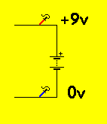

Year 10 Electronics
Chapter Two – The Research
The Power Supply for this circuit requires a standard type of supply.
A single Battery will produce
This basic supply uses a single Battery Connector
A positive Supply
A neutral Supply

Slide 17
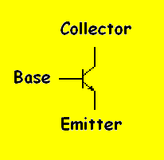

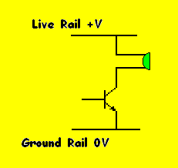
Year 10 Electronics
Chapter Two – The Research
Transistor
The transistor works like an ultra sensitive on/off switch.
When the voltage going into the base leg goes higher than 0.6 volts the transistor will switch on.
And the load component e.g. the buzzer will sound.

Slide 18
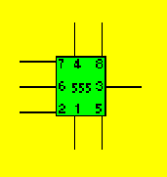
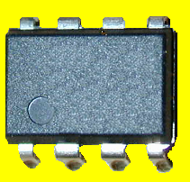
Year 10 Electronics
Chapter Two – The Research
Integrated Circuits (Microchips)
The Microchip for this circuit is called a 555 Timer Chip.
This type of chip is classified as an 8 Pin DIL
Positive power supply
8
7
6
5
1
2
3
4
The Symbol
The Picture
Neutral
Power
Supply
Output
Pin
Trigger
Pin

Slide 19
Year 10 Electronics
Chapter Two – The Research
The 555 Timer Chip can produce two kinds of output signals from leg 3 the output pin.
The first kind of output is called an Astable Signal.
This is where the output pin switches on & off in a regular pattern.
The second kind of output is called a Monostable Signal.
This is where the output pin switches on for a fixed length of time and then switches off. The output pin only switches on once and stays on for a fixed length of time.

Slide 20
Year 10 Electronics
Chapter Two – The Research
If you used an oscilloscope to view the signal pattern an Astable signal would look like this.
on
9v
Voltage
off
0v
Time
A Monostable signal would look like this.
9v
Voltage
0v

Slide 21
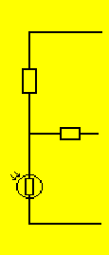
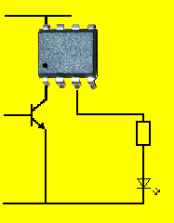
Year 10 Electronics
Chapter Two – The Research
Analogue/Digital Converter.
This is a circuit design that allows the variable signal from an analogue sensor to be used to switch a transistor on and off.
This is the analogue sensor
part of the circuit
This is the digital switching
part of the circuit
This is how the analogue/digital converter works.
As it gets darker the LDR gets stronger and the voltage at the variable output goes up.
When the voltage going into the base leg goes above 0.6v the transistor switches on the power to the 555 chip and the Astable output from pin 3 flashes the LED on/off.

Slide 22
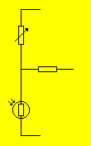
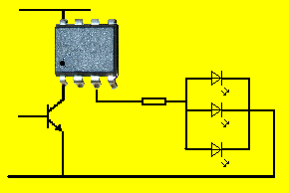
Year 10 Electronics
Chapter Two – The Research
The purpose of the variable resistor is to adjust the sensitivity of the analogue light sensor.
In this project the 555 Chip flashes three ultra bright LED’s at the same time.

